Slide 1
INTERNSHALA
PGC DATA SCIENCE
SQL PROJECT
TOPIC :- DEVELOPING AUCTION STRATEGY FOR NEW IPL FRANCHISE BY ANALYZING PAST IPL DATA TO CREATE A STRONG AND BALANCED SQUAD
NAME :- ADITYA PANI
BATCH :- 15TH APRIL

Slide 2
CREATING TABLE IPL_BALL AND IMPORTING DATA FROM CSV FILE.
QUERY :-
CREATE TABLE IPL_BALL(
ID INT,
INNING INT,
OVER INT,
BALL INT,
BATSMAN VARCHAR,
NON_STRIKER VARCHAR,
BOWLER VARCHAR,
BATSMAN_RUNS INT,
EXTRA_RUNS INT,
TOTAL_RUNS INT,
WICKET INT,
DISMISSAL_KIND VARCHAR,
PLAYER_DISMISSED VARCHAR,
FIELDER VARCHAR,
EXTRA_TYPE VARCHAR,
BATTING_TEAM VARCHAR,
BOWLING_TEAM VARCHAR);
IMPORTING DATA :-
COPY IPL_BALL FROM 'C:\Program Files\PostgreSQL\16\data\Data_copy\IPL Dataset\IPL_BALL.CSV'
DELIMITER ',' CSV HEADER;

Slide 3
CREATING TABLE IPL_MATCH AND IMPORTING DATA FROM CSV FILE.
QUERY :-
CREATE TABLE IPL_MATCH(
ID INT,
CITY VARCHAR,
DATE DATE,
PLAYER_OF_MATCH VARCHAR,
VENUE VARCHAR,
NEUTRAL_VENUE VARCHAR,
TEAM_1 VARCHAR,
TEAM_2 VARCHAR,
TOSS_WINNER VARCHAR,
TOSS_DECISION VARCHAR,
WINNER VARCHAR,
RESULTS VARCHAR,
RESULT_MARGIN INT,
ELIMINATOR VARCHAR,
METHOD VARCHAR,
UMPIRE_1 VARCHAR,
UMPIRE_2 VARCHAR);
IMPORTING DATA :-
COPY IPL_MATCH FROM 'C:\Program Files\PostgreSQL\16\data\Data_copy\IPL Dataset\IPL_MATCHES.CSV'
DELIMITER ',' CSV HEADER;

Slide 4
LIST OF 10 AGGRESSIVE PLAYERS WITH GOOD STRIKE_RATE.
QUERY :-
SELECT BATSMAN,SUM(BATSMAN_RUNS) AS TOTAL_RUNS,COUNT(BALL) AS BALLS_PLAYED,
ROUND((SUM(BATSMAN_RUNS)*1.0/COUNT(BALL))*100,2) AS STRIKE_RATE
FROM IPL_BALL
WHERE EXTRA_TYPE NOT IN ('wides')
GROUP BY BATSMAN
HAVING COUNT(BALL)>500
ORDER BY STRIKE_RATE DESC
LIMIT 10;

Slide 5
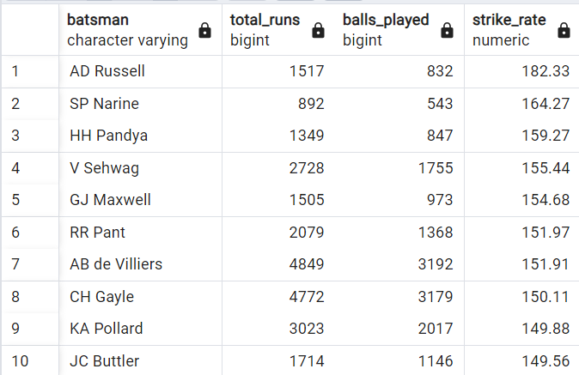

Slide 6
LIST OF 10 ANCHOR BATSMAN WITH GOOD AVERAGE.
QUERY :-
SELECT BATSMAN,SUM(BATSMAN_RUNS) AS BATSMAN_RUN,SUM(WICKET) AS DISMISSED,
ROUND((SUM(BATSMAN_RUNS)*1.0/SUM(WICKET)),2) AS AVERAGE
FROM IPL_BALL
GROUP BY BATSMAN
HAVING SUM(WICKET)>0 AND COUNT(DISTINCT ID)>28
ORDER BY AVERAGE DESC
LIMIT 10;
CRITERIA :-
I have taken 14 matches in 1 season i.e. only league matches.

Slide 7
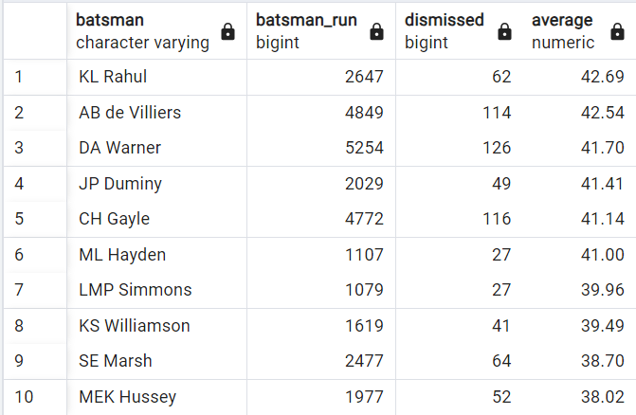

Slide 8
LIST OF 10 HARD HITTING BATSMAN WITH HIGHEST BOUNDARY PERCENTAGE
QUERY :-
SELECT BATSMAN,SUM(BATSMAN_RUNS) AS TOTAL_RUNS,
SUM(CASE WHEN BATSMAN_RUNS IN (4) THEN BATSMAN_RUNS ELSE 0 END) AS SUM_FOUR,
SUM(CASE WHEN BATSMAN_RUNS IN (6) THEN BATSMAN_RUNS ELSE 0 END) AS SUM_SIX,
ROUND(SUM(CASE WHEN BATSMAN_RUNS IN (4,6) THEN BATSMAN_RUNS ELSE 0 END)*1.0/SUM(BATSMAN_RUNS)*100,2) AS PERCENTAGE_BOUNDARIES
FROM IPL_BALL
WHERE EXTRA_TYPE NOT IN ('Wides')
GROUP BY BATSMAN
HAVING COUNT (DISTINCT ID) > 28
ORDER BY PERCENTAGE_BOUNDARIES DESC
LIMIT 10;
CRITERIA :-
I have taken 14 matches in 1 season i.e. only league matches.

Slide 9
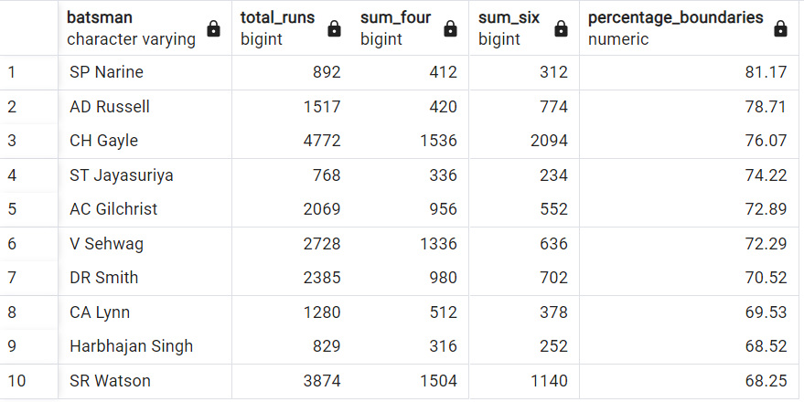

Slide 10
LIST OF 10 BOWLERS WITH GOOD ECONOMY.
QUERY :-
SELECT BOWLER,SUM(TOTAL_RUNS) AS RUNS_CONCEDED,COUNT(BALL) AS BALL_DELIVERED,
ROUND(SUM(TOTAL_RUNS)/(COUNT(BALL)/6.0),2) AS ECONOMY
FROM IPL_BALL
GROUP BY BOWLER
HAVING COUNT(BALL) > 500
ORDER BY ECONOMY
LIMIT 10;

Slide 11
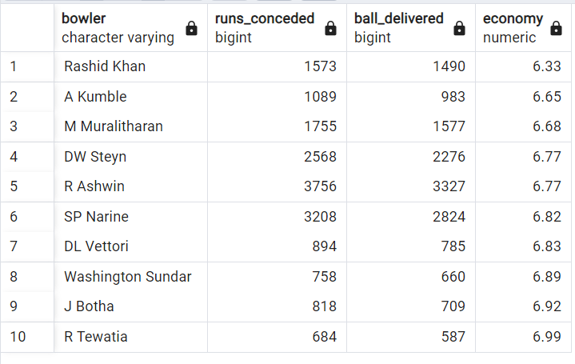

Slide 12
LIST OF 10 BOWLERS WITH GOOD BOWLING STRIKE RATE.
QUERY :-
SELECT BOWLER,COUNT(BALL) AS BALLS_DELIVERED,
SUM(CASE WHEN DISMISSAL_KIND IN ('caught','bowled','caught and bowled','lbw','stumped','hitwicket') THEN 1 ELSE 0 END) AS WICKET_TAKEN,
ROUND(COUNT(BALL)*1.0/SUM(CASE WHEN DISMISSAL_KIND IN ('caught','bowled','caught and bowled','lbw','stumped','hitwicket') THEN 1 ELSE 0 END),2) AS STRIKE_RATE
FROM IPL_BALL
GROUP BY BOWLER
HAVING COUNT(BALL)>500
ORDER BY STRIKE_RATE
LIMIT 10;

Slide 13
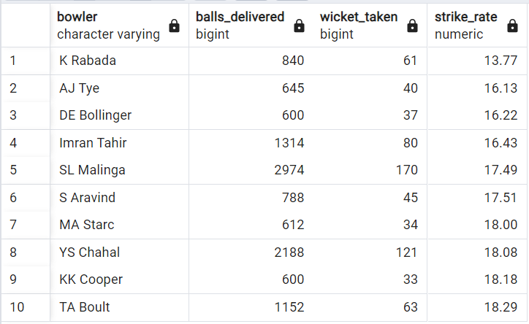

Slide 14
LIST OF 10 ALL_ROUNDERS WITH GOOD BATTING AND BOWLING STRIKE_RATE.
QUERY :-
SELECT A.*,B.BALLS_DELIVERED,B.WICKET_TAKEN,B.STRIKE_RATE_AS_BOWLER
FROM (SELECT BATSMAN AS PLAYERS,SUM(BATSMAN_RUNS) AS TOTAL_RUNS,COUNT(BALL) AS BALLS_PLAYED,
ROUND(SUM(BATSMAN_RUNS)*100/(COUNT(BALL)*1.0),2) AS STRIKE_RATE_AS_BATSMAN
FROM IPL_BALL
WHERE EXTRA_TYPE NOT IN ('wides')
GROUP BY BATSMAN
HAVING COUNT(BALL)>500
ORDER BY STRIKE_RATE_AS_BATSMAN DESC)
AS A INNER JOIN
(SELECT BOWLER AS PLAYERS,COUNT(BALL) AS BALLS_DELIVERED,
SUM(CASE WHEN DISMISSAL_KIND IN ('caught','bowled','caught and bowled','lbw','stumped','hitwicket') THEN 1 ELSE 0 END) AS WICKET_TAKEN,
ROUND(COUNT(BALL)*1.0/SUM(CASE WHEN DISMISSAL_KIND IN ('caught','bowled','caught and bowled','lbw','stumped','hitwicket') THEN 1 ELSE 0 END),2) AS STRIKE_RATE_AS_BOWLER
FROM IPL_BALL
GROUP BY BOWLER
HAVING COUNT(BALL)>300
ORDER BY STRIKE_RATE_AS_BOWLER) AS B
ON A.PLAYERS=B.PLAYERS
LIMIT 10;

Slide 15
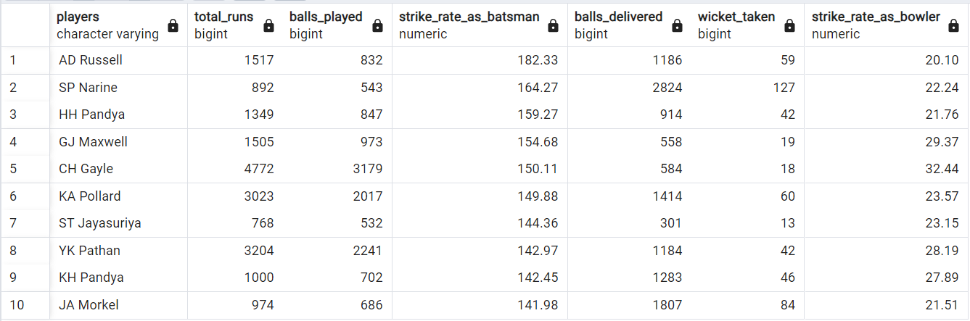

Slide 17
CRITERIA TO BUY A WICKETKEEPER
THERE ARE VARIOUS FACTORS TO BE CONSIDER WHILE CHOOSING A WICKET-KEEPER FOR IPL.
BATTING ABILITY :- IN IPL, AGGRESSIVE BATTING IS CRUCIAL FOR CHASING OR SETTING A TARGET. LOOKING FOR A WICKETKEEPER WHO CAN BAT WITH GOOD STRIKE RATE AND ABLE TO SCORE MORE RUNS IN BOUNDARY IN THE MIDDLE OR LOWER OVER WHICH CAN PUT PRESSURE ON THE OPPOSITE TEAM.
WICKETKEEPING SKILLS :- A WICKETKEEPER PRIMARY ROLE IS BEHIND THE STUMPS. LOOKING FOR A WICKETKEEPER WHO HAS EXCELLENT CATCHING AND STUMPING SKILLS.
DECISION MAKING :- A WICKETKEEPER SHOULD BE ABLE TO TAKE IMPORTANT DECISION BEHIND THE STUMPS AND GUIDE THE BOWLERS AND FIELDERS.
FITNESS AND DURABILITY :- SELECT A WICKETKEEPERS WHO ARE PHYSICALLY FIT AND HAVE A RECORD FOR LONG TERM WITHOUT INJURIES.A WICKETKEEPERS AVAILABILITY IS IMPORTANT FOR WHOLE TOURNAMENT.
MATCH WINNING ABILITY :- LOOK FOR WICKETKEEPERS WHO HAVE RECORD OF CONTRIBUTING MATCH WINNING PERFORMANCE WITH BOTH BAT AND GLOVES AND PLAY UNDER PRESSURE WHEN THE TEAM DOES NOT PLAY WELL.

Slide 18
ADDITIONAL QUESTIONS

Slide 19
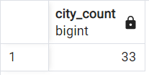
Q1
QUERY :-
SELECT COUNT(DISTINCT(CITY)) AS CITY_COUNT
FROM IPL_MATCH;

Slide 20
Q2
QUERY :-
CREATE TABLE DELIVERIES_V02 AS SELECT *, CASE
WHEN TOTAL_RUNS >= 4 THEN 'Boundary'
WHEN TOTAL_RUNS= 0 THEN 'DOT'
ELSE 'OTHERS'
END AS BALL_RESULT
FROM IPL_BALL

Slide 21
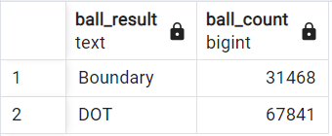
Q3
QUERY :-
SELECT BALL_RESULT AS BALL_RESULT, COUNT(BALL_RESULT) AS BALL_COUNT
FROM DELIVERIES_V02
WHERE BALL_RESULT NOT IN ('OTHERS')
GROUP BY BALL_RESULT;

Slide 22
Q4
QUERY :-
SELECT BATTING_TEAM,COUNT(BALL_RESULT) AS BOUNDARY_COUNT
FROM DELIVERIES_V02
WHERE BALL_RESULT IN ('Boundary')
GROUP BY BATTING_TEAM
ORDER BY BOUNDARY_COUNT DESC;

Slide 23
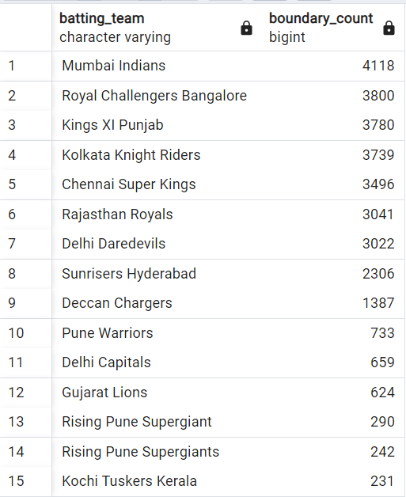

Slide 24
Q5
QUERY :-
SELECT BOWLING_TEAM,COUNT(TOTAL_RUNS) AS DOT_COUNT
FROM IPL_BALL
WHERE TOTAL_RUNS = 0 AND BOWLING_TEAM NOT IN ('NA')
GROUP BY BOWLING_TEAM
ORDER BY DOT_COUNT DESC;

Slide 25
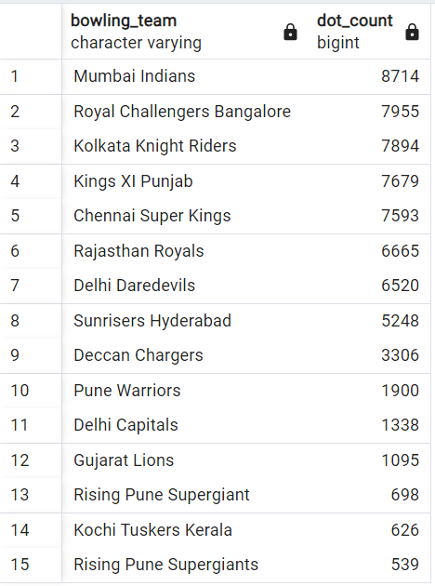

Slide 26
Q6
QUERY :-
SELECT DISMISSAL_KIND,COUNT(DISMISSAL_KIND) AS DISMISSAL_COUNT
FROM DELIVERIES_V02
WHERE DISMISSAL_KIND NOT IN ('NA')
GROUP BY DISMISSAL_KIND;

Slide 27
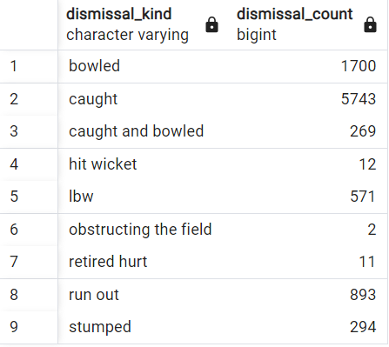

Slide 28
Q7
QUERY :-
SELECT BOWLER AS PLAYER,SUM(EXTRA_RUNS) AS EXTRA_RUN
FROM DELIVERIES_V02
GROUP BY BOWLER
ORDER BY EXTRA_RUN DESC
LIMIT 5;

Slide 29
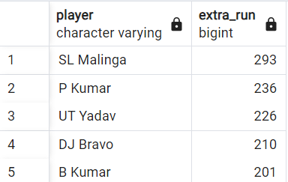

Slide 30
Q8
QUERY:-
CREATE TABLE DELIVERIES_V03 AS
SELECT A.*,B.VENUE,B.DATE
FROM DELIVERIES_V02 AS A
LEFT JOIN IPL_MATCH AS B
ON A.ID=B.ID;

Slide 31
Q9
QUERY :-
SELECT VENUE,SUM(TOTAL_RUNS) AS RUNS_CONCEDED_IN_VENUE
FROM DELIVERIES_V03
GROUP BY VENUE
ORDER BY RUNS_CONCEDED_IN_VENUE DESC;

Slide 32
venue | runs_conceded_in_venue
Eden Gardens | 23658
Wankhede Stadium | 23390
Feroz Shah Kotla | 22947
M Chinnaswamy Stadium | 20237
Rajiv Gandhi International Stadium, Uppal | 19484
MA Chidambaram Stadium, Chepauk | 17821
Sawai Mansingh Stadium | 14264
Punjab Cricket Association Stadium, Mohali | 10987
Dubai International Cricket Stadium | 10402
Sheikh Zayed Stadium | 8830
Punjab Cricket Association IS Bindra Stadium, Mohali | 7021
Maharashtra Cricket Association Stadium | 6780
Sharjah Cricket Stadium | 5924
M.Chinnaswamy Stadium | 5127
Dr DY Patil Sports Academy | 4810
Subrata Roy Sahara Stadium | 4755
Kingsmead | 4353
Brabourne Stadium | 3842
Dr. Y.S. Rajasekhara Reddy ACA-VDCA Cricket Stadium | 3746
Sardar Patel Stadium, Motera | 3746
SuperSport Park | 3653
Saurashtra Cricket Association Stadium | 3316
Himachal Pradesh Cricket Association Stadium | 2897
Holkar Cricket Stadium | 2872
New Wanderers Stadium | 2292
Barabati Stadium | 2278
JSCA International Stadium Complex | 2056
St George's Park | 2033
Newlands | 1764
Shaheed Veer Narayan Singh International Stadium | 1741
Nehru Stadium | 1363
Green Park | 1298
De Beers Diamond Oval | 897
Vidarbha Cricket Association Stadium, Jamtha | 882
Buffalo Park | 799
OUTsurance Oval | 529

Slide 33
Q10
QUERY :-
SELECT EXTRACT(YEAR FROM DATE) AS YEAR,SUM (TOTAL_RUNS) AS TOTAL_RUNS
FROM DELIVERIES_V03
WHERE VENUE = 'Eden Gardens'
GROUP BY YEAR
ORDER BY TOTAL_RUNS DESC;

Slide 34
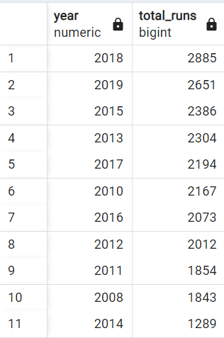

Slide 35
THANK YOU

